Slide 1
Data Preprocessing
Presented By:
Talha Ahmed Siddiqui
BSAI–F23-A
231230

Slide 2
Table of Contents
Introduction: AI/ML Pipeline
Focus on Data Preprocessing
Data Cleaning
Outliers
Data Transformation
Encoding Categorical Variables
Impact of Preprocessing
Next Steps

Slide 3
Introduction: What is the AI Pipeline?
The AI pipeline refers to the structured sequence of steps needed to turn raw data into meaningful insights or predictions using AI models.
These steps ensure that data is transformed, processed, and analyzed effectively.

Slide 4
Introduction: AI Pipeline
Data Collection
Data Preprocessing
Data Exploration
Model Selection and Training
Model Deployment
Monitoring, Maintenance, Feedback
Problem Identification

Slide 5
Focus on Data Preprocessing
The cleaning, transforming, and integrating of data in order to make it ready for analysis.
The goal is to improve the quality of the data and to make it more suitable for the specific data mining task.

Slide 6
Data Cleaning
Definition: Data cleaning is the process of detecting and correcting (or removing) corrupt, inaccurate, or irrelevant records from a dataset.
Objective: Improve the data’s quality and reliability, making it suitable for analysis and modeling.

Slide 7
Handling Missing Data
Missing data refers to the absence of values in a dataset where observations or measurements should exist.
Ways to Handle Missing Data:
Imputations
Removing Rows
Interpolation
Forward Fill / Backward Fill

Slide 8
Imputations
The process of filling in missing or null values in a dataset with substitute values.
Types of Imputations
Mean
Median
Mode

Slide 9
Mean Imputation
Replace missing values with the mean of the non-missing values in the column.
Best suited for numerical data that is symmetrically distributed (without many outliers).
For example, if the values in a column are [25, 27, 29, NaN, 30], the missing value will be replaced with the mean of 27.75.

Slide 10
Median Imputation
Replace missing values with the median of the non-missing values in the column.
Preferred for numerical data with skewed distributions (outliers), as the median is less sensitive to extreme values than the mean.
Example: For the values [36, 27, 45, NaN, 72], if we were to use the median, the missing value would be filled with 40.5.

Slide 11
Mode Imputation
Replace missing values with the mode (most frequent value) of the column.
Typically used for categorical data (e.g., gender or product category), where filling with the most common value makes sense.
Example: For categories [‘A’, ‘B’, ‘A’, NaN, ‘A’], mode imputation would replace the missing value with 'A', as it is the most frequent value.

Slide 12
Removing Rows
Entire rows or columns where there are too many missing values (beyond a certain defined threshold) can be removed.
Similarly, if a column contains a constant value across most or all rows, it will not contribute to identifying patterns in the data.
Additionally, if a column does not contribute to analysis or modeling, it can be removed.

Slide 13
Interpolation
A method used to estimate missing values in a dataset based on the known data points around it.
It fills in the gaps in data by predicting values for missing entries based on the patterns or relationships in the existing data.

Slide 14
Linear interpolation is used when missing data lies between two known data points and you can assume that the trend between the points is linear.
Time (Hours) | Temperature (°C)
8 | 20
9 | Nan
10 | 24
Assuming a linear relationship, the interpolated temperature is 22°C.

Slide 15
Forward/Backward Fill
Forward Fill:
The missing value is replaced with the most recent valid value before it.
Used when past values are more reliable indicators of current trends.
Backward Fill
The missing value is replaced with the next valid value after it.
Used when future values can reliably represent earlier gaps.

Slide 16
Why Data Cleaning is Crucial
Improves Model Accuracy:
Clean data leads to better predictions and model performance.
Reduces Bias and Errors:
Minimizes skewed results caused by incorrect or inconsistent data.
Saves Time:
Cleaning data upfront reduces the need for extensive corrections later.

Slide 17
Outliers
Outliers are data points that deviate significantly from the rest of the dataset. They can be unusually high or low values compared to the expected range.
Why Handle Outliers?
To improve data quality.
To avoid misleading insights.
To ensure model accuracy by removing anomalies.

Slide 18
Handling Outliers
Statistical Methods
Z-Score
Interquartile Range
Visual Methods:
Box plots
Scatter plots

Slide 19
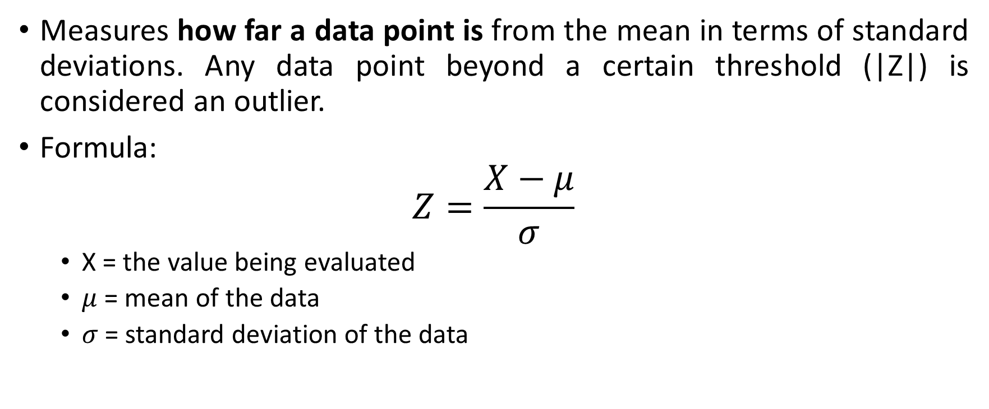
Z-Score
Measures how far a data point is from the mean in terms of standard deviations. Any data point beyond a certain threshold (|Z|) is considered an outlier.
Formula:
$$Z=\frac{X−μ}{σ}$$
X = the value being evaluated
$μ$ = mean of the data
$σ$ = standard deviation of the data

Slide 20
Z-Score Example
Value | Z-Score
50 | -0.45
55 | -0.43
60 | -0.40
65 | -0.37
70 | -0.34
500 | 2.00
Typically, a threshold of |Z|>3 is set and any Z-Score value exceeding this is regarded as an outlier.
In this case, it can be adjusted to remove the obviously larger data point.

Slide 21
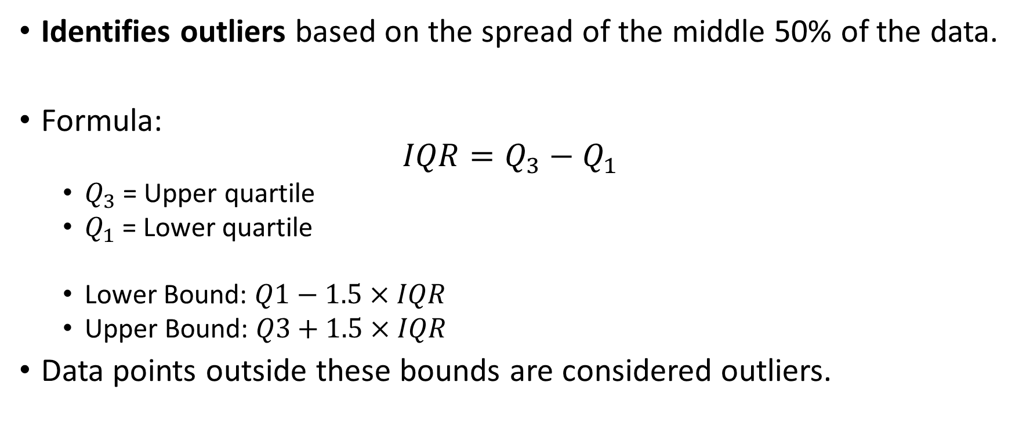
Inter-Quartile Range
Identifies outliers based on the spread of the middle 50% of the data.
Formula:
$$IQR=Q_{3}−Q_{1}$$
$Q_{3}$ = Upper quartile
$Q_{1}$ = Lower quartile
Lower Bound: $Q1−1.5×IQR$
Upper Bound: $Q3+1.5×IQR$
Data points outside these bounds are considered outliers.

Slide 22
Box Plot
A visual tool used to summarize data distributions and detect outliers.
It displays the following:
Median (Q2): The middle value of the data.
First Quartile (Q1): 25th percentile of the data.
Third Quartile (Q3): 75th percentile of the data.
Whiskers: Extend to the smallest and largest values within 1.5×IQR from Q1 and Q3.
Outliers: Data points beyond the whiskers.
Outlier are identified using the IQR method.

Slide 23
Scatter Plot
Visually represents relationships between two numerical variables.
How to Detect Outliers
Visualize Data:
Plot each data point based on two variables (e.g., XXX and YYY).
Identify Outliers:
Look for points that lie significantly far from the rest of the data.

Slide 24
Example:
In the above table, the data point (50,1000000) is the obvious outlier as it is far removed from the income trend.
Age | Income
25 | 35,000
30 | 45,000
35 | 55,000
40 | 60,000
45 | 70,000
50 | 1,000,000

Slide 25
Data Transformations
Converting data into a format or structure suitable for analysis.
Methods:
Standardization (Z-score normalization)
Normalization (Min-Max Scaling)
Benefit:
Improve interpretability, comparability, and model performance

Slide 26
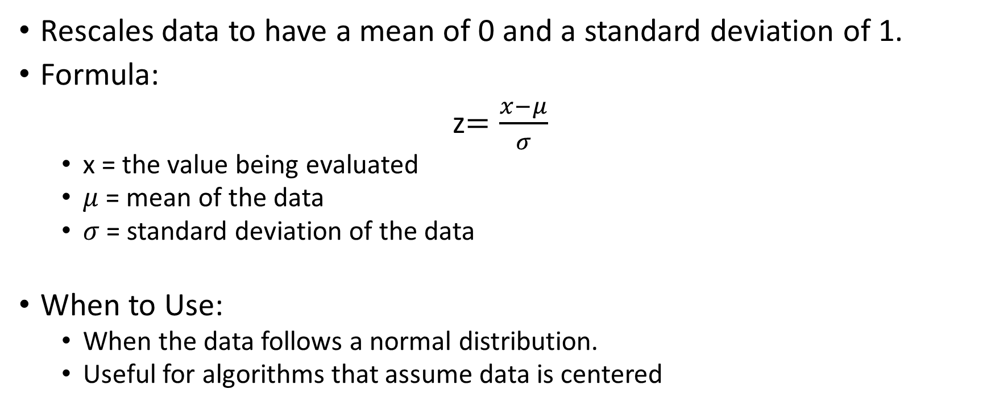
Standardization
Rescales data to have a mean of 0 and a standard deviation of 1.
Formula:
z$=\frac{x−μ}{σ}$
x = the value being evaluated
$μ$ = mean of the data
$σ$ = standard deviation of the data
When to Use:
When the data follows a normal distribution.
Useful for algorithms that assume data is centered

Slide 27
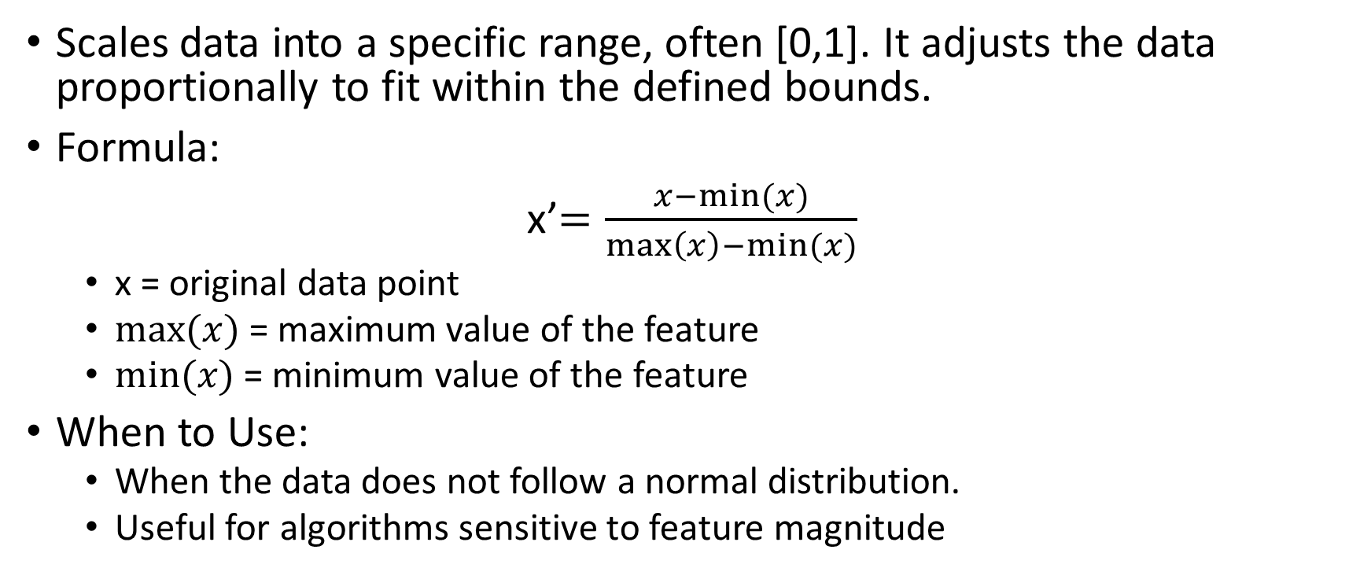
Normalization
Scales data into a specific range, often [0,1]. It adjusts the data proportionally to fit within the defined bounds.
Formula:
x’$=\frac{x−min⁡(x)}{\max\left(x\right)−min⁡(x)}$
x = original data point
$max⁡(x)$ = maximum value of the feature
$min⁡(x)$ = minimum value of the feature
When to Use:
When the data does not follow a normal distribution.
Useful for algorithms sensitive to feature magnitude

Slide 28
Example:
For a dataset: [50, 60, 70, 80, 90]
Original Value | Standardized Value | Normalized Value
50 | -1.14 | 0.0
60 | -0.57 | 0.25
70 | 0.00 | 0.5
80 | 0.57 | 0.75
90 | 1.14 | 1.0

Slide 29
Encoding
Transforming categorical data (non-numeric data like text labels) into numerical values that can be used by machine learning algorithms.
Most machine learning algorithms require input data to be in a numeric format.
Types of Encoding:
One hot Encoding
Label Encoding
Frequency Encoding
Target Encoding

Slide 30
One Hot Encoding
Creates binary (0 or 1) columns for each category in the original column.
It works well when there is no ordinal relationship between categories.
Example:
Blue | Green | Red
1 | 0 | 0
0 | 0 | 1
0 | 1 | 0

Slide 31
Label Encoding
Assigns a unique integer to each category.
Suitable for models that can handle ordinal data where the categories have a meaningful order (e.g. small, medium, large).
Example:
Color | Color_Encoded
Red | 0
Green | 1
Blue | 2
Green | 1
Blue | 2

Slide 32
Frequency Encoding
Each unique category is replaced with the number of times it occurs in the dataset.
Simple to implement and useful for categorical features with many categories.
Example:
City | Frequency_Encoded
Lahore | 3
Karachi | 2
Karachi | 2
Lahore | 3
Lahore | 3

Slide 33
Target Encoding
Involves replacing each category in a categorical column with the mean of the target variable for that category.
It is especially useful when a categorical variable has a direct impact on the target variable.
Example:
City | Sales | Target_Encoded
Lahore | 500 | 666.67
Karachi | 600 | 750
Lahore | 700 | 666.67
Lahore | 800 | 666.67
Karachi | 900 | 750

Slide 34
Impact of Preprocessing
Improves Data Quality
Removes noise, inconsistencies, and errors in the data
Enhances Model Performance
Preprocessed data leads to better predictions
Enables Model Compatibility
Many machine learning algorithms cannot work directly with raw data, especially categorical features or missing values.

Slide 35
Next Steps
EDA
EDA helps you understand the characteristics of the dataset.
It’s important to explore the cleaned data to ensure it’s ready for modeling or further analysis.
Feature Engineering
If needed, you can create new features that might improve the performance of a machine learning model.
Model Selection
If you're preparing the data for machine learning models, the next step would be to select a suitable model.

